Slide 1
2D CONFORMAL MESHING IN UPXO
- Dr. Sunil Anandatheertha
Materials Engineer, UKAEA

Slide 2
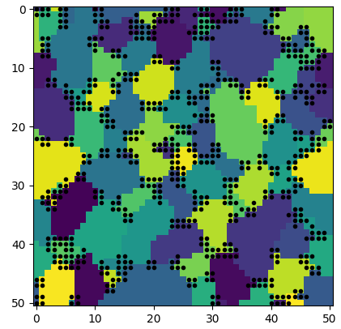
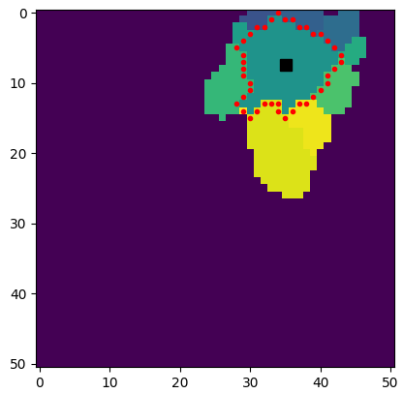
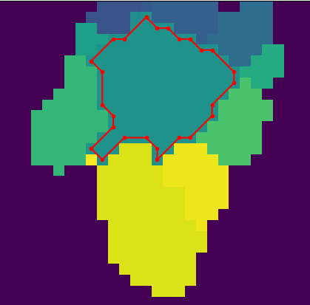
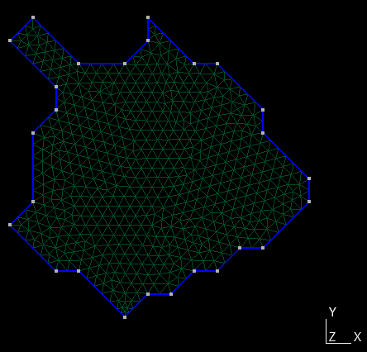
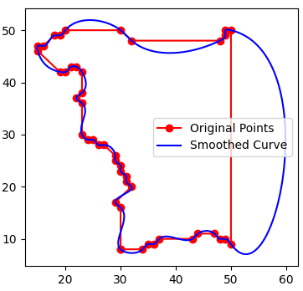
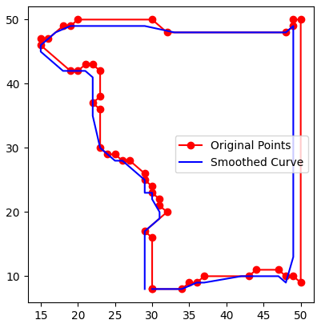
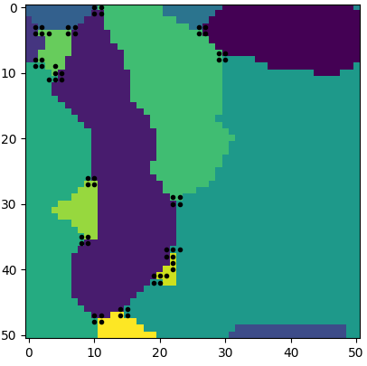
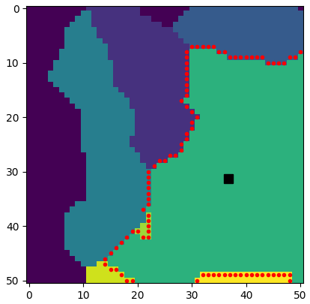
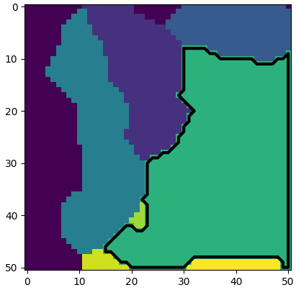
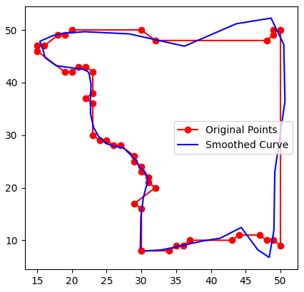
Identify Grain Boundary Junction points
Get grain boundary points of example grain (largest grain)
Make UPXO multi-edge
Mesh the grain

Slide 3
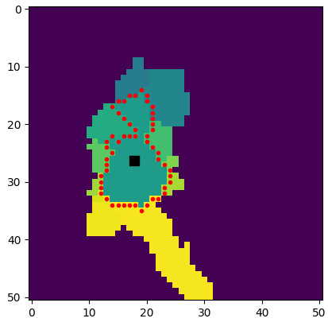


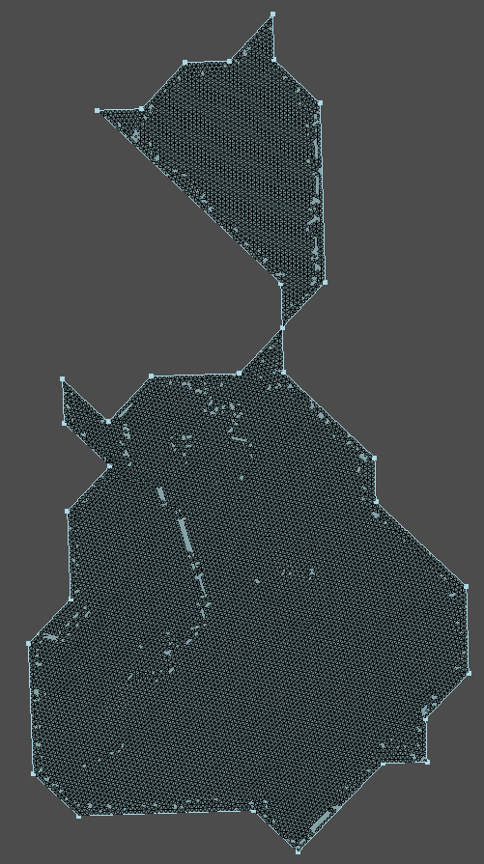
However, topological considerations ore re-considerations needed !!
One easy solution is to scale down the original grain structure by a factor of 2, which would increase the pixel density, thereby avoiding these singular throats in topologies.

